Slide 1
From Bluescreens to Scripts:
Enhancing Troubleshooting with Microsoft Copilot

Slide 2
Attention
MMS sessions are 60-75 minutes followed by LONG Q&A
Please hold detailed questions until that Q&A starts
Feel free to ask clarification questions
Remind the speakers to use Zoom It when you can’t see

Slide 3


Johan Arwidmark
Mikael Nystrom
Technical Fellow
Microsoft MVP
Johan.Arwidmark@mirolus.com
@jarwidmark
deploymentbunny@outlook.com
@mikael_nystrom

Slide 4
The First Section
With a little description here

Slide 5
Session outcomes
Analyze bluescreen minidumps with Copilot and get actionable remediation guidance
Parse and summarize noisy event logs in seconds
Generate documentation, reports, and comms artifacts instantly
Create PowerShell and automation scripts from natural language prompts
Reduce mean-time-to-resolution (MTTR) for real incidents
MMSMOA 2026
Truesec
Notes:
Emphasize hands-on applicability and reproducible workflows.

Slide 6
Agenda (60–75 minutes)
How Copilot fits into real troubleshooting workflows (5 min)
Bluescreen analysis with Copilot (15 min)
Event log triage without losing signal (15 min)
From errors to scripts: PowerShell generation (15 min)
Docs, reports, and handovers in seconds (10 min)
Live prompts, pitfalls, and Q&A (10 min)
MMSMOA 2026
Truesec
Notes:
Mention live demos and that prompts will be shareable.

Slide 7
1. Copilot for Operators
Where it actually adds value
MMSMOA 2026
Truesec

Slide 8
The troubleshooting reality
Incidents are noisy and time-pressured
Logs are verbose and poorly correlated
Scripts are rewritten from scratch too often
Documentation lags behind reality
Humans waste time doing mechanical work
MMSMOA 2026
Truesec
Notes:
Position Copilot as an accelerator for expert judgment.

Slide 9
Where Copilot shines
Pattern recognition at scale
Summarizing large, messy data sets
Translating errors into hypotheses
Generating first-draft scripts
Turning raw analysis into clean outputs
MMSMOA 2026
Truesec
Notes:
Not replacing expertise—amplifying it.

Slide 10
2. Bluescreens with Copilot
From dump files to root cause
MMSMOA 2026
Truesec

Slide 11
Typical BSOD workflow (before)
Collect minidump
Open WinDbg
Manually inspect stack and symbols
Search error codes
Hope the answer is obvious
MMSMOA 2026
Truesec
Notes:
Acknowledge audience pain here.

Slide 12
Copilot prompt: Analyzing a minidump
Analyze this Windows minidump and summarize:
- BugCheck code and parameters
- Likely faulty component or driver
- Whether this points to hardware, driver, or configuration
- Concrete remediation steps specific to this system
MMSMOA 2026
Truesec
Notes:
Explain: include context like OS version, VM/physical, recent changes.

Slide 13
Copilot output you care about
Clear hypothesis (not guesses)
Confidence level expressed
Specific drivers or subsystems named
Actionable next steps
Requests for missing data when needed
MMSMOA 2026
Truesec
Notes:
Stress validation: Copilot suggestions must be verified.

Slide 14
3. Event Log Triage
Extracting signal from noise
MMSMOA 2026
Truesec

Slide 15
The problem with event logs
Thousands of events per hour
Repetitive warnings
Multiple providers shouting
Correlation across logs is hard
Humans burn time scrolling
MMSMOA 2026
Truesec
Notes:
Set up why Copilot helps here.

Slide 16
Copilot prompt: Event log summarization
Summarize these event logs for the time window 10:00–11:00:
- Group related events
- Identify the probable root cause
- Call out red flags vs benign noise
- Provide a timeline of what likely happened
MMSMOA 2026
Truesec
Notes:
Mention attaching exported EVTX or pasted text.

Slide 17
Practical tips
Always scope by time window
Provide system role context
Ask for a timeline, not a list
Iterate with follow-up prompts
Cross-check with metrics/traces
MMSMOA 2026
Truesec
Notes:
This improves result quality dramatically.

Slide 18
4. From Errors to Scripts
PowerShell with natural language
MMSMOA 2026
Truesec

Slide 19
Why this matters
Troubleshooting often ends with 'we should automate this'
Scripts are repetitive but need precision
Context switching slows you down
Copilot can draft 80% instantly
MMSMOA 2026
Truesec
Notes:
Position Copilot as script scaffolding.

Slide 20
Copilot prompt: Generate a PowerShell script
Create a PowerShell script that:
- Collects CPU, memory, disk, and network usage
- Exports event logs for System and Application
- Saves output to a timestamped folder
- Handles errors gracefully
- Is compatible with Windows Server 2019+
MMSMOA 2026
Truesec
Notes:
Mention: always review, test, and secure scripts.

Slide 21
Review checklist
Validate assumptions
Check permissions and scope
Sanitize inputs
Add logging
Version and sign scripts
MMSMOA 2026
Truesec
Notes:
Copilot speeds coding, not governance.

Slide 22
Copilot Troubleshooting Toolkit
Log Collection Pack + Copilot Agent for Log Analysis
MMSMOA 2026 • Truesec
MMSMOA 2026
Truesec
Notes:
Introduce the idea: make troubleshooting repeatable. One script produces a standard bundle; one agent analyzes it consistently.

Slide 23
Part A
Create a Copilot Log Collection Pack
MMSMOA 2026
Truesec

Slide 24
What a 'Copilot log pack' is
A standardized folder + ZIP structure with predictable paths
Contains: logs, configuration snapshots, and lightweight perf evidence
Optimized for AI analysis: time-scoped, de-duplicated, and labeled
Safe to share: redaction + access control
Repeatable: same bundle format across servers/clients
MMSMOA 2026
Truesec
Notes:
Key: structure is everything. Copilot performs best when file names and folders are consistent.

Slide 25
Recommended pack structure
\BundleRoot
\SystemInfo (msinfo32, installed updates, drivers)
\Events (System/Application/Setup exported EVTX)
\Servicing (CBS.log, DISM.log, WindowsUpdate logs)
\AppLogs (application logs, crash dumps)
\Perf (perf counters BLG + lightweight CSV)
\Network (ipconfig, route, dns, netsh traces if needed)
\ReadMe.txt (system role, incident window, symptoms)
MMSMOA 2026
Truesec
Notes:
Add a ReadMe with role/time window. It massively increases answer quality.

Slide 26
Collection approach (example outline)
# 1) Create timestamped output folder
# 2) Export EVTX (System/Application/Setup) for the incident window
# 3) Copy servicing logs: C:\Windows\Logs\CBS\CBS.log and C:\Windows\Logs\DISM\DISM.log
# 4) Copy app logs / crash dumps (if present)
# 5) Collect perf evidence (e.g., logman data collector set)
# 6) Gather configuration snapshots (ipconfig /all, route, installed updates)
# 7) Compress to ZIP and write a manifest.json
MMSMOA 2026
Truesec
Notes:
This is a slide-friendly outline. In the session you can show a real script snippet if you want.

Slide 27
Part B
Create a Copilot agent to analyze bundles
MMSMOA 2026
Truesec

Slide 28
Agent design goals
Accept a ZIP or folder of logs
Auto-detect: system role, timeframe, and primary failure domains
Parse servicing: DISM.log + CBS.log and extract actionable errors
Summarize app errors/misconfig and correlate with events
Assess basic performance: CPU, memory pressure, disk latency, network saturation
Generate outputs: executive summary + technical deep dive + next steps
MMSMOA 2026
Truesec
Notes:
This is where it becomes 'cool': repeatable triage with consistent structure.

Slide 29
Agent architecture (practical)
1) Knowledge source: SharePoint/OneDrive folder that stores bundles
2) File input: allow users to upload ZIPs in chat
3) Flow/tool: Power Automate tool to save file + extract key files
4) Analysis prompt: run a structured prompt against extracted text
5) Output: summary + detected issues + recommended commands
MMSMOA 2026
Truesec
Notes:
Emphasize: permissions are honored; scope the knowledge source to a dedicated 'Log Bundles' library.

Slide 30
Agent instruction template (system prompt style)
You are a Windows troubleshooting agent.
When a user provides a log bundle, do the following:
1) Identify OS/build, role (client/server), and incident time window.
2) Extract and summarize key errors from: CBS.log, DISM.log, System/Application events.
3) Categorize findings: Servicing, App, Identity, Storage, Network, Performance.
4) For each category: Symptoms, Evidence (file + timestamp), Probable cause, Next actions.
5) Provide a concise 'Top 5 actions' list.
Always ask for missing context if confidence is low.
MMSMOA 2026
Truesec
Notes:
This is the reusable instruction block for Copilot Studio. Keep it stable across deployments.

Slide 31
Outputs to generate (make it operational)
✅ 1-page executive summary (impact, cause, actions)
✅ Technical timeline (event correlation)
✅ Servicing errors table (code, package, remediation)
✅ Performance snapshot (CPU/memory/disk/network) + likely bottleneck
✅ Script recommendations (safe, copy/paste)
MMSMOA 2026
Truesec
Notes:
Tell the audience: this turns troubleshooting into a productized process.

Slide 32
5. Docs, Reports, and Handover
Closing the loop fast
MMSMOA 2026
Truesec

Slide 33
The forgotten work
Incident summaries
Customer communications
Post-mortems
Runbook updates
Shift handovers
MMSMOA 2026
Truesec
Notes:
Audience will recognize this pain instantly.

Slide 34
Copilot prompt: Incident summary
Create a concise incident summary for a technical audience:
- What happened
- Impact
- Root cause
- Remediation
- Preventive actions
MMSMOA 2026
Truesec
Notes:
Explain re-prompting for exec vs technical versions.

Slide 35
Pitfalls & Guardrails
Using Copilot safely and effectively
MMSMOA 2026
Truesec

Slide 36
Common mistakes
Trusting output blindly
Providing too little context
Leaking sensitive data
Skipping validation
Assuming Copilot replaces expertise
MMSMOA 2026
Truesec
Notes:
Be responsible but not alarmist.

Slide 37
Best practices
Be explicit in prompts
Attach real data
Ask for uncertainty and alternatives
Iterate
Keep humans in the loop
MMSMOA 2026
Truesec
Notes:
End on empowerment, not fear.

Slide 38
Final takeaway
Work smarter, not louder
MMSMOA 2026
Truesec

Slide 39
If you take one thing away
Copilot reduces toil, not thinking
Use it to compress time-to-insight
Standardize prompts across teams
Pair outputs with verification
Free yourself for harder problems
MMSMOA 2026
Truesec
Notes:
Strong close tying back to MTTR reduction.

Slide 40
Prompt Appendix
Steal these Copilot prompts
MMSMOA 2026
Truesec

Slide 41
Prompt 1 – Bluescreen Analysis
Analyze this Windows minidump and explain:
- BugCheck code and parameters
- Likely faulty driver/component
- Hardware vs driver vs configuration
- Confidence level
- Remediation steps
MMSMOA 2026
Truesec

Slide 42
Prompt 2 – Event Log Triage
Summarize these event logs:
- Group related events
- Identify root cause
- Separate noise from signal
- Provide a timeline
MMSMOA 2026
Truesec

Slide 43
Prompt 3 – Hypothesis Validation
Evaluate this hypothesis:
<insert hypothesis>
- Evidence for
- Evidence against
- Alternative explanations
- Next diagnostic step
MMSMOA 2026
Truesec

Slide 44
Prompt 4 – PowerShell Script Generation
Create a PowerShell script that:
- Collects system health
- Exports event logs
- Saves to timestamped folder
- Handles errors
- Works on Server 2019+
MMSMOA 2026
Truesec

Slide 45
Prompt 5 – Incident Summary
Create an incident summary:
- What happened
- Impact
- Root cause
- Remediation
- Preventive actions
MMSMOA 2026
Truesec

Slide 46
Welcome
Don’t be shy
We won’t talk about the Society for Critical Care Medicine
Long live … Intune?
Use Zoom It
My Data | Day | Week
123 | 3 | M
456 | 5 | W
789 | 7 | F

Slide 47
How to win at life
According to Brian

Slide 48
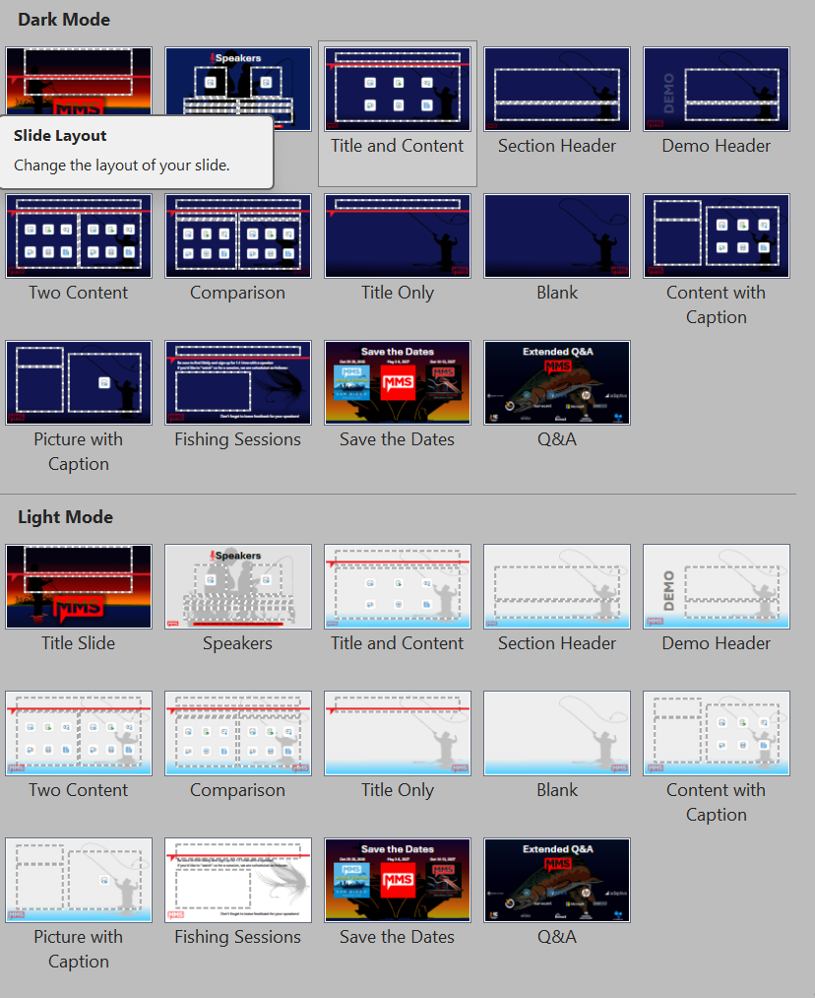
Don't Cross The Streams!
New for this year: LIGHT MODE
Use one or the other; NOT BOTH.
Session Title, Save the Dates, and Q&A are the same regardless of mode.

